Slide 1
Formal Specification Methods

Slide 2
Disadvantages of Natural Language Specification
Ambiguity and room for interpretation
Multiple levels of specificity and/or abstraction in a single specification
Verbosity (leads to larger documents)

Slide 3
Another Perspective – Dangers of Physical Representations in Analysis
Over Specification
- Y2K problem, Postal code problem – tied in the logical to the
physical representation
Multiple representation
- Stack as a array, list etc.
- We may want to change the representation at a later point in time.

Slide 4
Towards Abstraction
View an object by its operation, not by its representation
Principle of selfishness:
If I am thirsty, an orange is something I can squeeze. If I am a painter, it is color which might inspire my palette, If I am a farmer, it is produce that I can sell at the market, but if I am none of these, and have no other use for the orange, then I should not talk about it, as the concept of orange does not for me even exist.

Slide 5
Mathematical Modeling
Involves translating input space (I) to the output space (O) by a function F
Ex: F(I) = O
Program is a mathematical object and Language being used is a mathematical notation. Therefore, we can prove certain properties about it. For example, what the software do it is supposed to do and do it something that is not supposed to do.
It will help us to prove this.

Slide 6
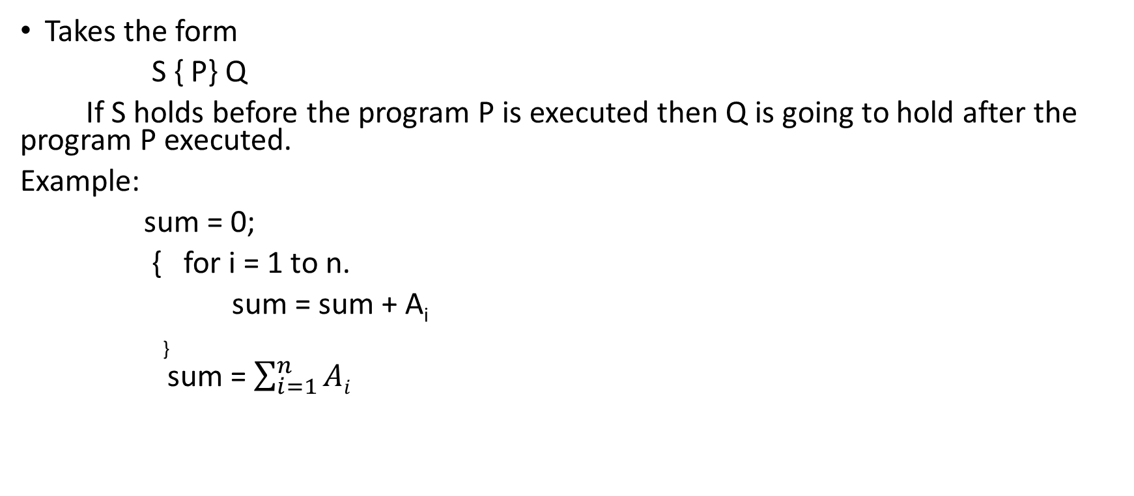
I/O Assertions
Takes the form
S { P} Q
If S holds before the program P is executed then Q is going to hold after the program P executed.
Example:
sum = 0;
{ for i = 1 to n.
sum = sum + A_{i}
}
sum = $\sum_{i=1}^{n}{Ai}$

Slide 7
What does a Abstract Data Type (ADT) consist of ?
Types
- Collection of objects characterized by features, axioms
- Specification is a declaration
- Example: PrintingDevice
Definition of type of the object is going to be laid out. It can be a parameterized type (a list of integers)
or raw type (example, a date).
Operations/Functions
- Operations applicable to the instances
- Eg. Push: G, Stack(G) => Stack(G)
- Multiple types
- Creators (create new instances, example, date or stack )
- Queries (used to extract the state whatever the data type already contains at a given point of time,
read the state or manipulate the state)
- Commands (setting the date)
- Partial Functions
- Cannot apply these under certain conditions
- Example: Cannot pop on an empty stack, Cannot push on a full stack

Slide 8
What about Post Conditions?
Class Invariants and Post Conditions apply only to the operational or imperative style of expression
- ADTs promote the declarative style
- Implication that a existing data structure is manipulated rather than
returning a new data structure each time
- Classes have state, ADTs do NOT!

Slide 9
Stack ADT
Type
Stack [G] - contains the elements of the type G
Operations
NEWSTACK -> STACK[G] returns a stack of type G
PUSH: Stack[G], G -> STACK[G] -non declarative or
non-imperative style
of programming in ADT
Push operation takes two parameters (existing stack and an
element) and it returns an other stack. Not manipulating the
existing stack.
POP: Stack[G] -> STACK[G]
TOP: Stack[G] -> G
isEmpty: Stack[G] -> BOOLEAN its query operation

Slide 10
PRECONDITION
POP : ISEMPTY --> FALSE You cannot pop an empty stack
AXIOMS (Rules)
ISEMPTY(NEWSTACK): -> TRUE
POP(NEWSTACK) :-> ERROR
TOP(NEWSTACK): -> ERROR
TOP( PUSH(NEWSTACK, G)) -> G

Slide 11
Algebraic Manipulations using Axioms
top(pop(push(pop(push(push(pop(push(push(push(new, x1), x2), x3)), top(pop(push(push(new, x4), x5)))), x6)), x7)))
Work this one out using Axioms of the Stack ADT!
- x4
This is true no matter what representation of the stack that you choose to implement it.

Slide 12
Abstract Math to Concrete realizations
ADTs to classes (module of OO design)
Classes can be either of:
- Deferred (partially implemented or abstract)
- Useful in analysis and design
- Effective (fully implemented or concrete)
- A must in implementation

Slide 13
ADTs and Information Hiding
Public part:
ADT specification (E1)
Secret part:
Choice of representation (E2)
Implementation of functions by features (E3)
Information hiding is an important aspect of software modularization. That part of the ADT or software module is needed for interaction with other module is needed to be exposed.
Detailed Implementation of the functions need not to be exposed that to be differed.

Slide 14
Completeness of Specification
Can we answer this question?
- Reference point?
Mathematically
- If the axioms can be used to prove any other expression that can
be constructed from the language of the theory
- Well formed expressions only count
- Push(G) is NOT well formed since it also needs a stack as an
argument
- Top (new) – is it well formed? If so, is it meaningful?
- Structural integrity as well as semantic integrity needs to be checked
for Query expressions and their importance in this evaluation

Slide 15
Ex:
ReplaceITEM ( Stack[G], G ) -> Stack[G]
If ( ISEMPTY = FALSE)
PUSH(POP(Stack[G]), G)
ReplaceITEM is a compound operation whereas ISEMPTY, PUSH, POP are atomic operations.
Syntactically meaningful expressions and semantically correct.

Slide 16
Definition: sufficient completeness
An ADT specification for a type T is sufficiently complete if and only if the axioms of the theory make it possible to solve the following problems for any well-formed expression e:
- S1: Determine whether e is correct.
- S2: If e is a query expression and has been shown to be correct
under S1, express e’s value under a form not involving any value of
type T.

Slide 17
ADT Consistency
An ADT specification is consistent if and only if, for any well-formed query expression e, the axioms make it possible to infer at most one value for e.

Slide 18
UNIX DIRECTORY
Type: UDIR
Operations:
/ : -> UDIR root
mkdir : UDIR x NAME -> UDIR present working directory
and a name gives you
another new directory
cd : UDIR X ID -> UDIR
pwd: UDIR -> ID ID = name or string (path)
isname: ID -> BOOLEAN whether exist within the
directory

Slide 19
Axioms
PWD(/) = “/” ;
PWD( mkdir(D, i)) = PWD(D)
PWD ( cd(D, i)) = PWD (i)

Slide 20
LIST (EXAMPLE2)
Type List[G]
Operations
CREATE -> List[G]
INSERT : List x i x G -> List[G] list, index and item
DELETE : List x i -> List[G] list and index
RETRIEVE: List x i -> G list and index
ISEMPTY: List -> BOOLEAN
LENGTH: List -> INT returns an integer

Slide 21
Axioms
ISEMPTY(CREATE) = TRUE
ISEMPTY(INSERT((CREATE), G1) = FALSE

